Slide 1
Online Employment Recruitment System
By:
Mohana Rupa Kalluri

Slide 2
Project Description
The Online Recruitment System is a web-based application designed to streamline the hiring process by connecting job seekers with recruiters and administrators. The system features four distinct user modules: Admin, Recruiter, Job Seeker, and Company, each equipped with specific functionalities to facilitate efficient recruitment.

Slide 3
Key Features
NoSQL Structure: Uses MongoDB Atlas with collections instead of tables.
Role-Based Access: Clear separation between Admin, Recruiter, and Job Seeker roles.
Cloud Deployment: Collections optimized for Render and MongoDB Atlas integration.
CRUD Operations: All collections support Create, Read, Update, Delete functions.
User Roles: Supports multiple user roles including recruiters and job seekers, each with tailored functionalities.
Job Postings: Recruiters can create, view, and manage job postings.
Job Applications: Job seekers can apply to available positions, upload resumes, and track application statuses.
Interview Scheduling: Recruiters can schedule interviews, define interview rounds, and provide feedback.
Application Tracking: Both recruiters and job seekers can monitor the status of applications and interviews.
Session Management: Secure login and session handling for different user roles.

Slide 4
User Modules:
Admin Module:
The Admin manages the overall system, including monitoring job postings, vetting recruiters, and reviewing job seeker applications.
Admins have default login credentials to access the system and can approve or reject recruiter registrations.
They can also add new skills to the database, which are visible to both recruiters and job seekers.
Recruiter Module:
Recruiters can register on the platform by providing their details. After admin approval, they can log in and access the system.
They have the ability to post job openings (full-time or part-time), manage applications, and schedule interviews with candidates.
Recruiters can review job seeker profiles and decide whether to accept or reject applications based on qualifications.
Job Seeker Module:
Job seekers create accounts to maintain profiles that include resumes, skills, and educational backgrounds.
They can search for job postings that match their qualifications and apply by submitting their resumes and cover letters.
Once applications are submitted, job seekers can track their application status and view scheduled interviews
Company Module:
Companies can register on the platform to create a profile that includes information about their business, culture, and job offerings.
Each company can have multiple recruiters associated with it, allowing them to post job openings and manage applications.
Companies can also view the status of job postings and applications submitted by job seekers..

Slide 5
Process Flow
Registration & Profile Setup: Job seekers register and create comprehensive profiles showcasing skills and experience. Recruiters register, providing company details, and await admin approval to ensure platform integrity.
System Administration: Admins manage the platform, vetting recruiters to maintain quality and monitoring job postings to ensure relevance and compliance.
Job Applications & Review: Job seekers apply for suitable job postings. Recruiters review applications, shortlist candidates, schedule interviews, and make informed hiring decisions.
Communication & Coordination: The system streamlines communication between job seekers and recruiters, ensuring a transparent and efficient recruitment process. Notifications and messaging features enhance engagement and coordination for all stakeholders

Slide 6
Database Description
.
Database Engine: MongoDB Atlas
The application uses MongoDB Atlas, a cloud-based NoSQL database service, for efficient data storage and management. Its flexible schema design is well-suited for the dynamic nature of the Online Recruitment System, allowing for seamless modifications as the application evolves. Key collections include: job_posts, job_applications, interviews, recruiters, job_seekers, and companies, each representing critical entities in the recruitment process.

Slide 7
Backend Technology
Programming Language: Python with Flask framework.
The backend of the application is developed using Python, which interacts with the MongoDB database through a library such as PyMongo or Flask-PyMongo. This allows for seamless CRUD (Create, Read, Update, Delete) operations on the database.

Slide 8
Frontend Technologies
Markup Language: HTML
HTML templates rendered using Flask's render_template function.
Styling Language: CSS
The user interface is built using HTML for structure and CSS for styling, providing a responsive and user-friendly experience for job seekers, recruiters, and administrators.

Slide 9
Database Structure
The database consists of several collections to represent the different entities within the recruitment system:
Users Collection:
Fields:
UserId: Unique identifier for each user.
Username: User's login name.
Password: Hashed password for authentication.
Role: User role (Admin, Recruiter, Job Seeker).
Details: Object containing personal information (e.g., name, email, contact number).

Slide 10
Companies Collection:
Fields:
CompanyId: Unique identifier for each company.
Name: Name of the company.
Description: Brief description of the company.
Location: Company location.
Website: Company website URL.
Recruiters: Array of references to recruiters associated with the company.

Slide 11
Jobs Collection:
Fields:
jobId: Unique identifier for each job posting.
title: Job title.
description: Detailed job description.
requirements: List of required skills and qualifications.
type: Job type (full-time, part-time).
postedBy: Reference to the recruiter who posted the job.

Slide 12
Applications Collection:
Fields:
ApplicationId: Unique identifier for each application.
JobId: Reference to the job being applied for.
SeekerId: Reference to the job seeker applying.
Resume: Link to the uploaded resume.
CoverLetter: Link to the uploaded cover letter.
Status: Application status (pending, accepted, rejected).

Slide 13
Interviews Collection:
Fields:
InterviewId: Unique identifier for each interview.
ApplicationId: Reference to the application for which the interview is scheduled.
ScheduledTime: Date and time of the interview.
Status: Interview status (scheduled, completed, rescheduled).

Slide 14
Skills Collection:
Fields:
SkillId: Unique identifier for each skill.
SkillName: Name of the skill.
AddedBy: Reference to the admin who added the skill.

Slide 15
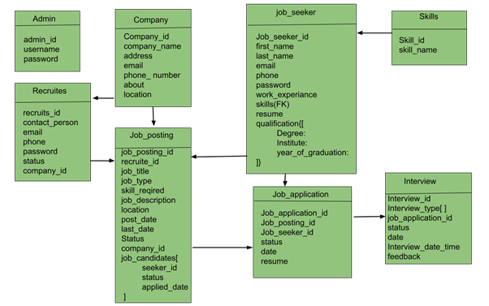
Database Diagram

Slide 16
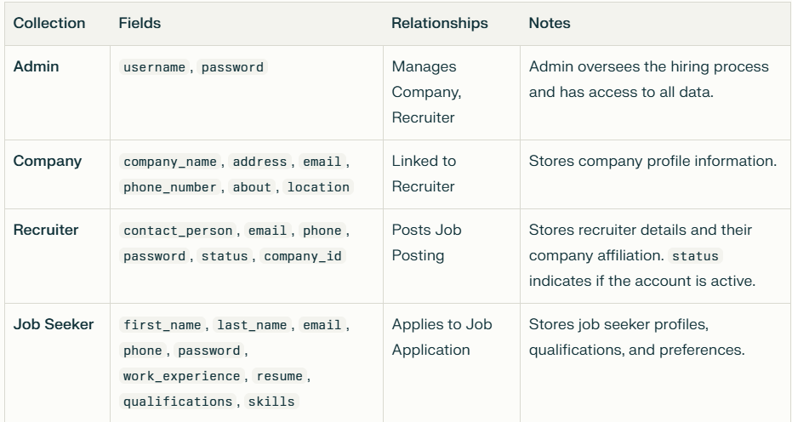
Schema Design (MongoDB Collections)

Slide 17
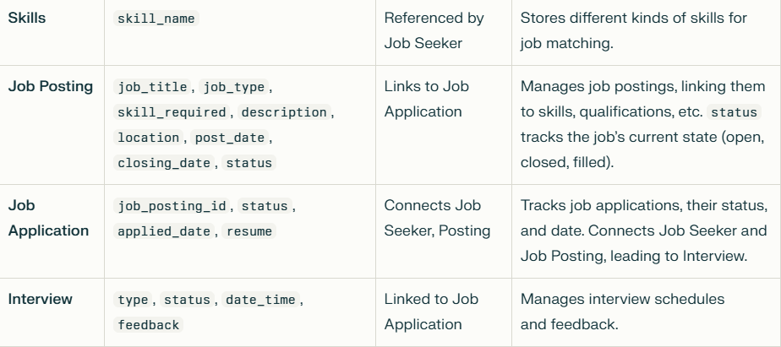

Slide 18
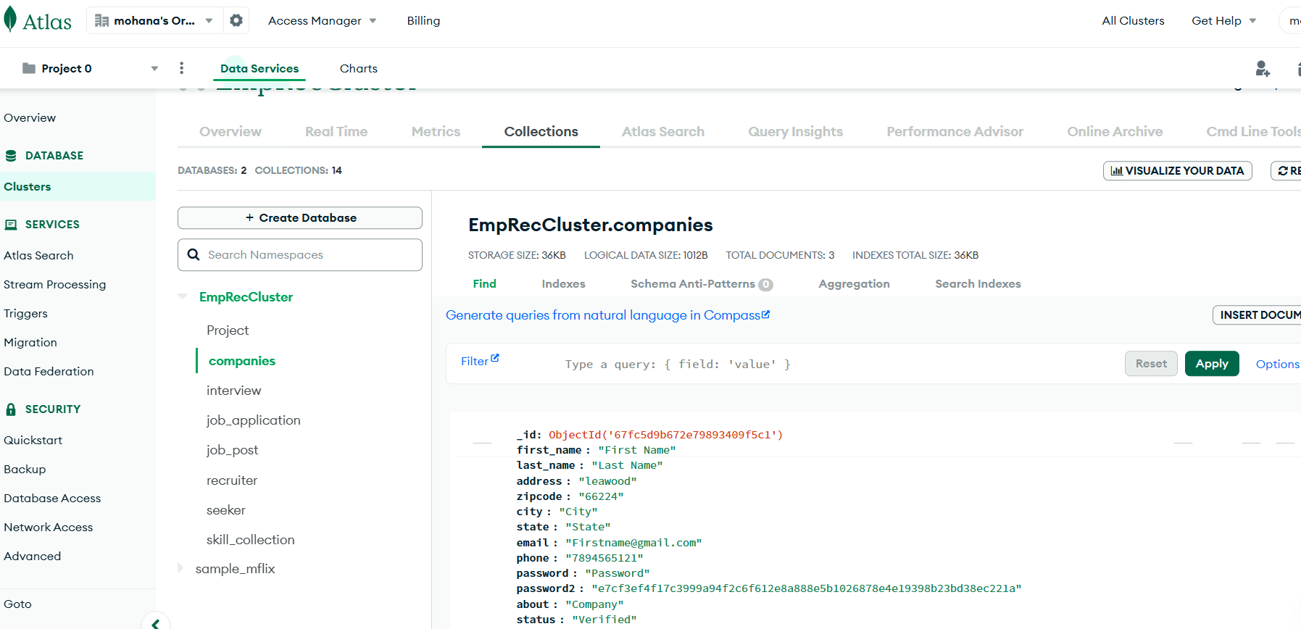
Database Collections:

Slide 19

Web Pages
Home page :

Slide 20
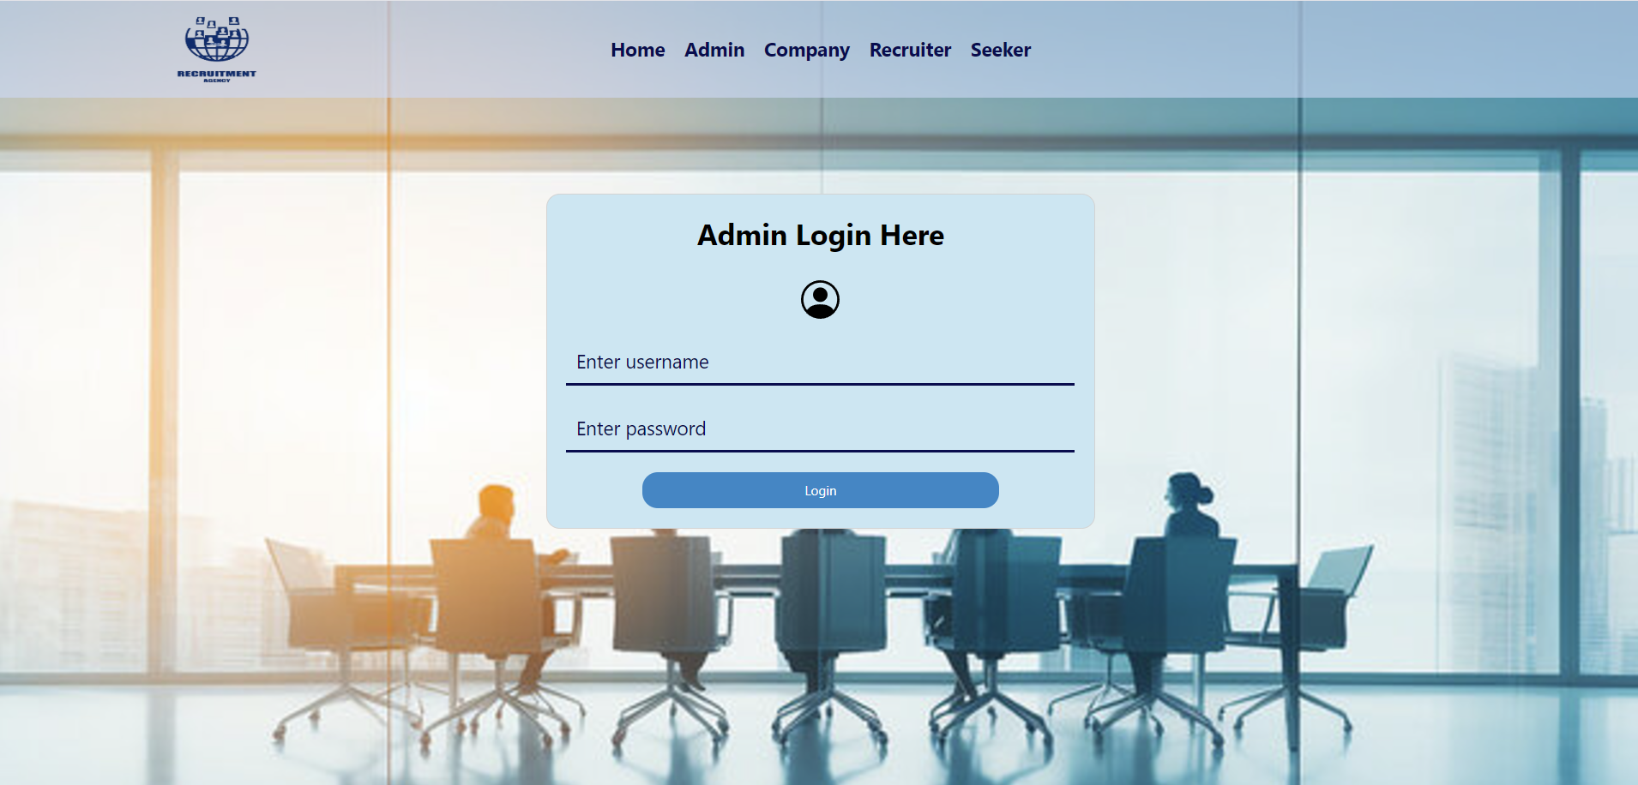
Admin Login Page :

Slide 21
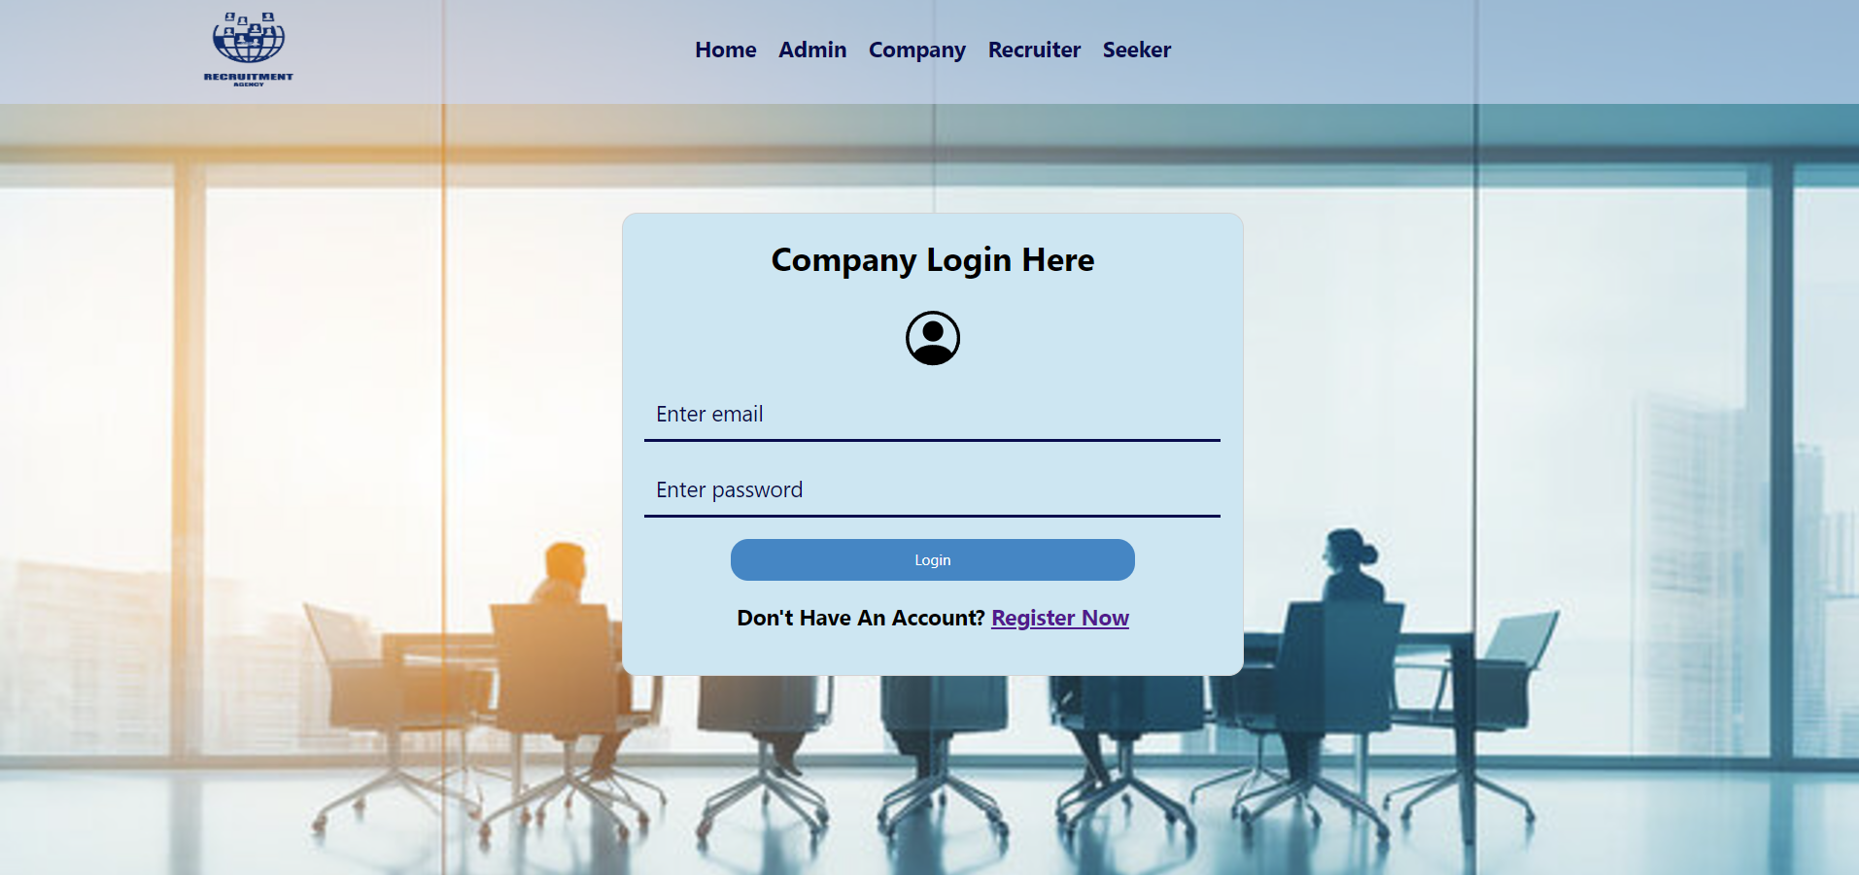
Company Login Page :

Slide 22
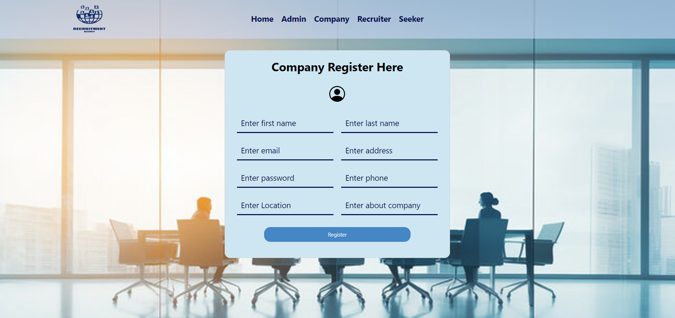
Company Registration Page :

Slide 23
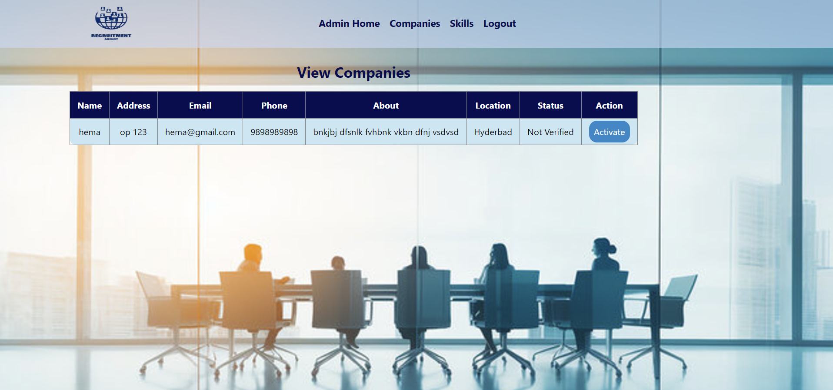
Admin View / Verify Companies Page:

Slide 24
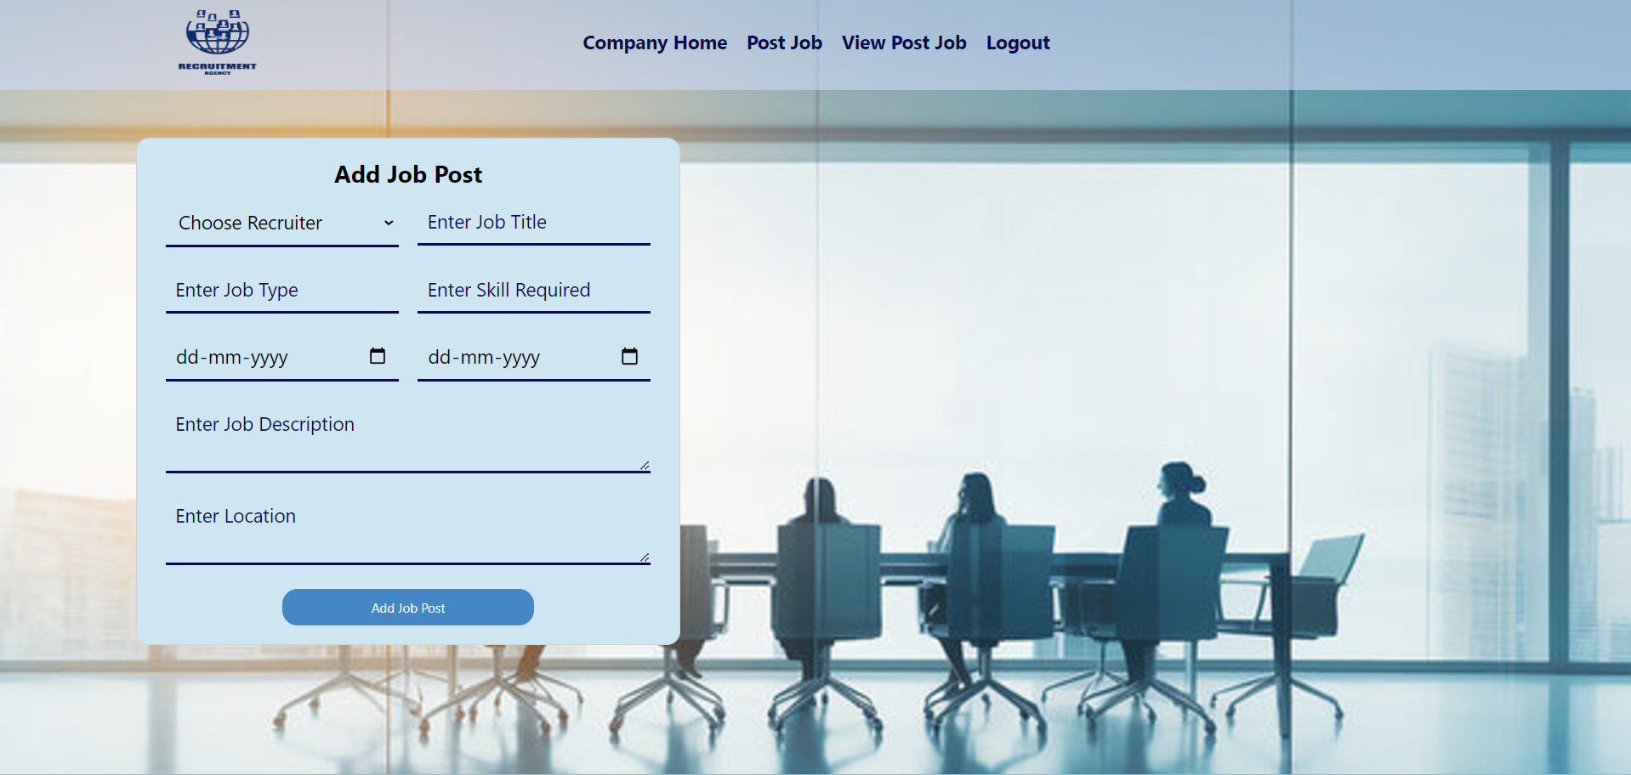
Add Job Post Page :

Slide 25
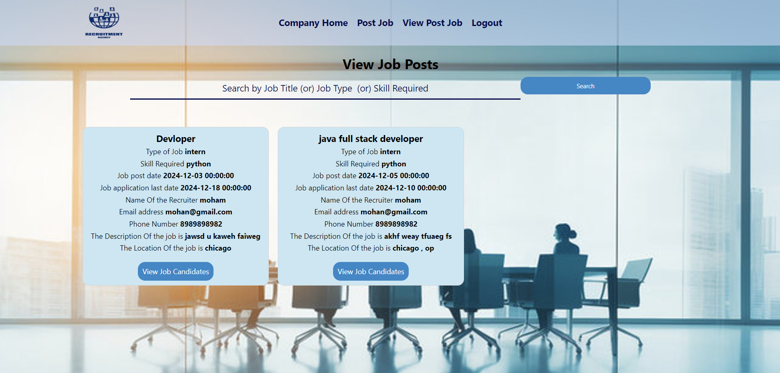
View Job Post Page :

Slide 26
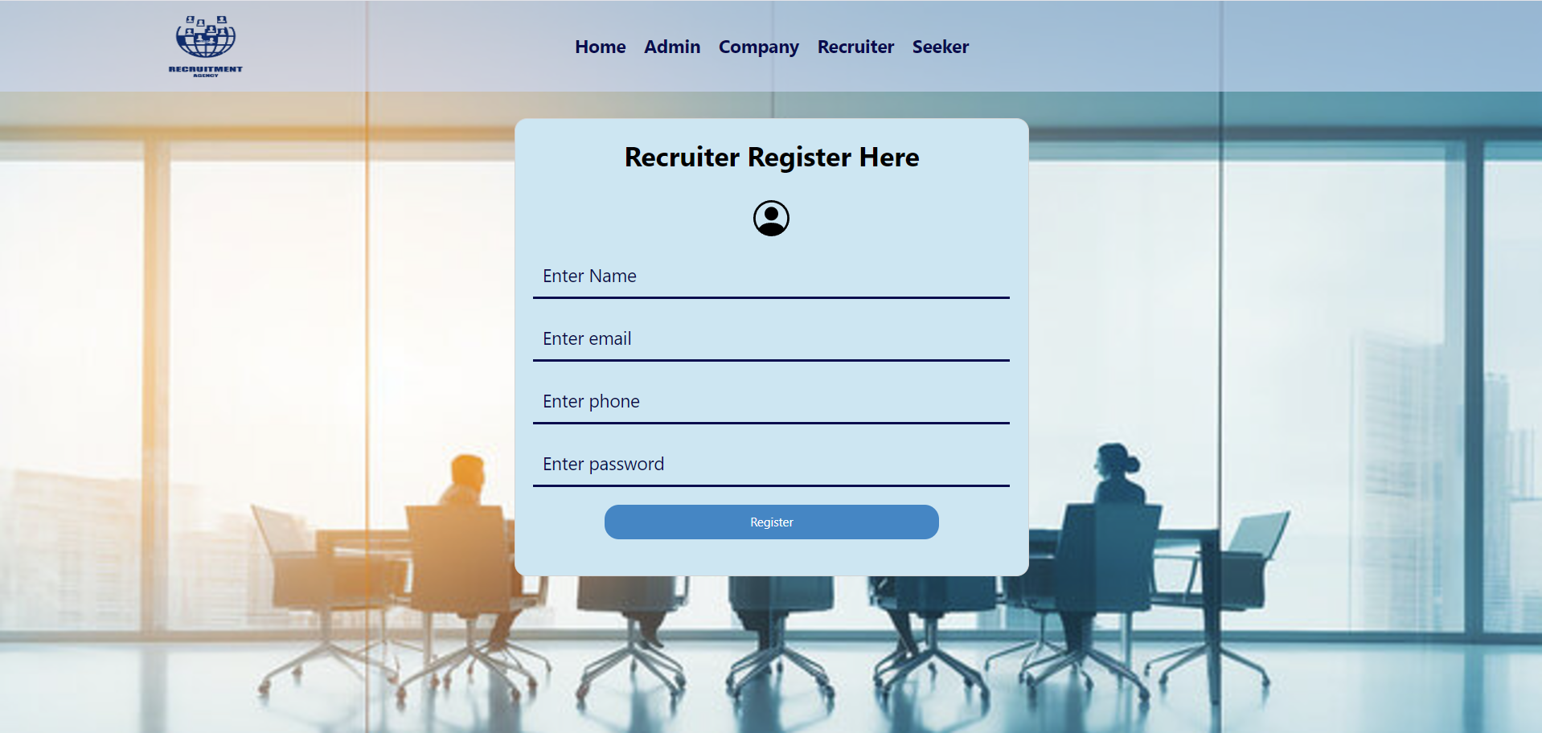
Recruiter Registration Page :

Slide 27

Recruiter Login Page :

Slide 28
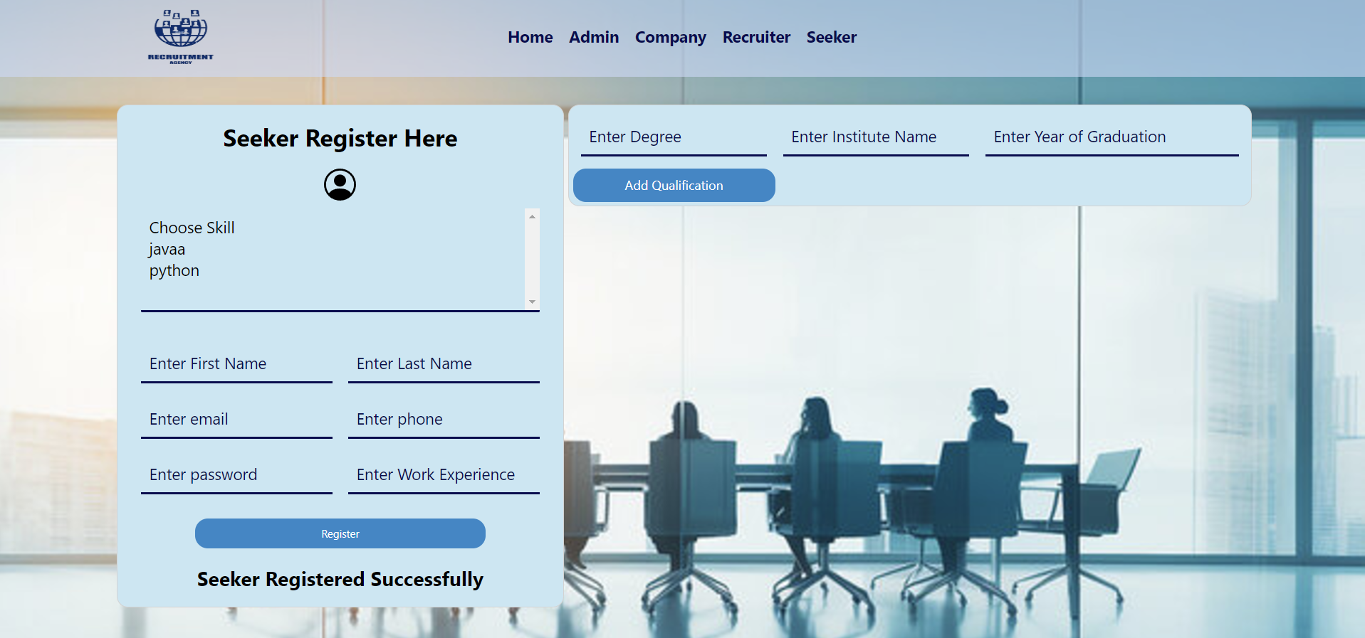
Seeker Registration Page :

Slide 29
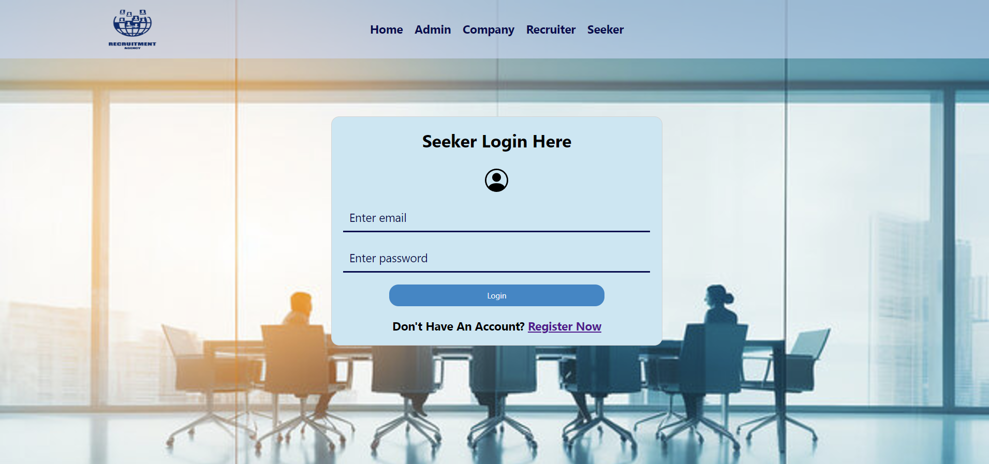
Seeker Login Page :

Slide 30

View Seeker Profile Page :

Slide 31
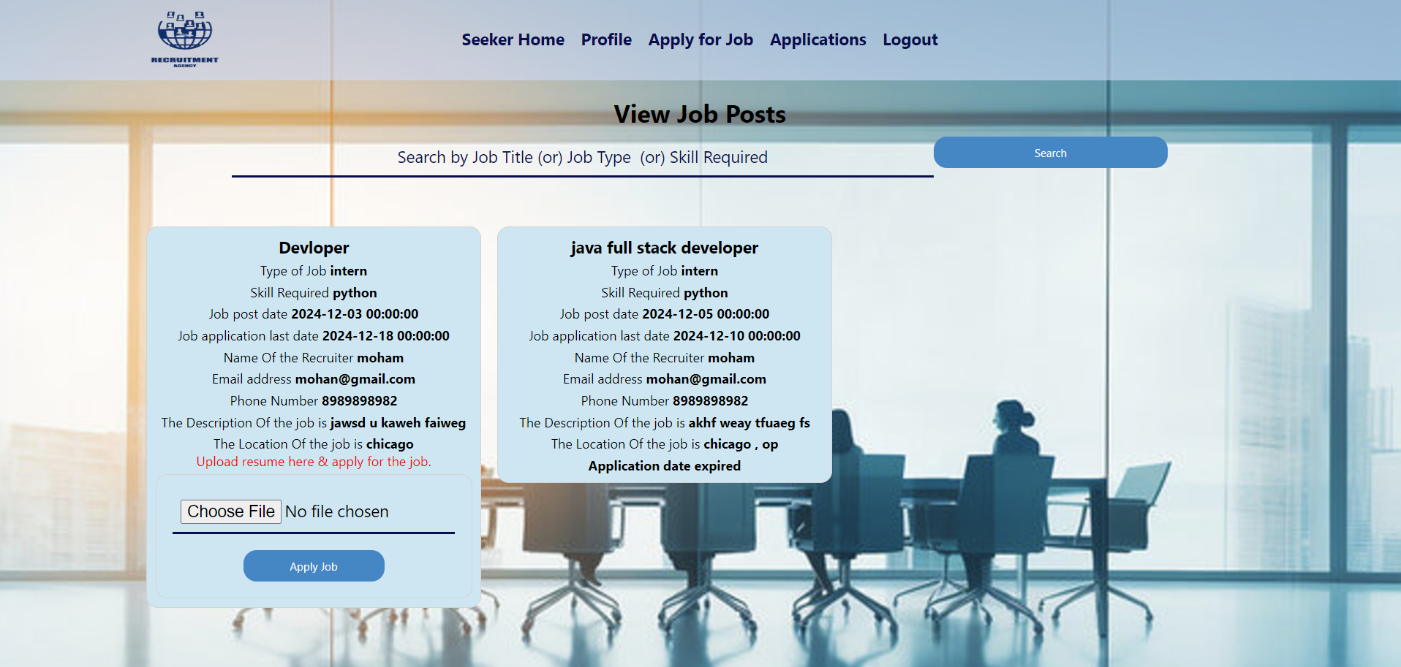
Seeker View Job Posts Page :

Slide 32
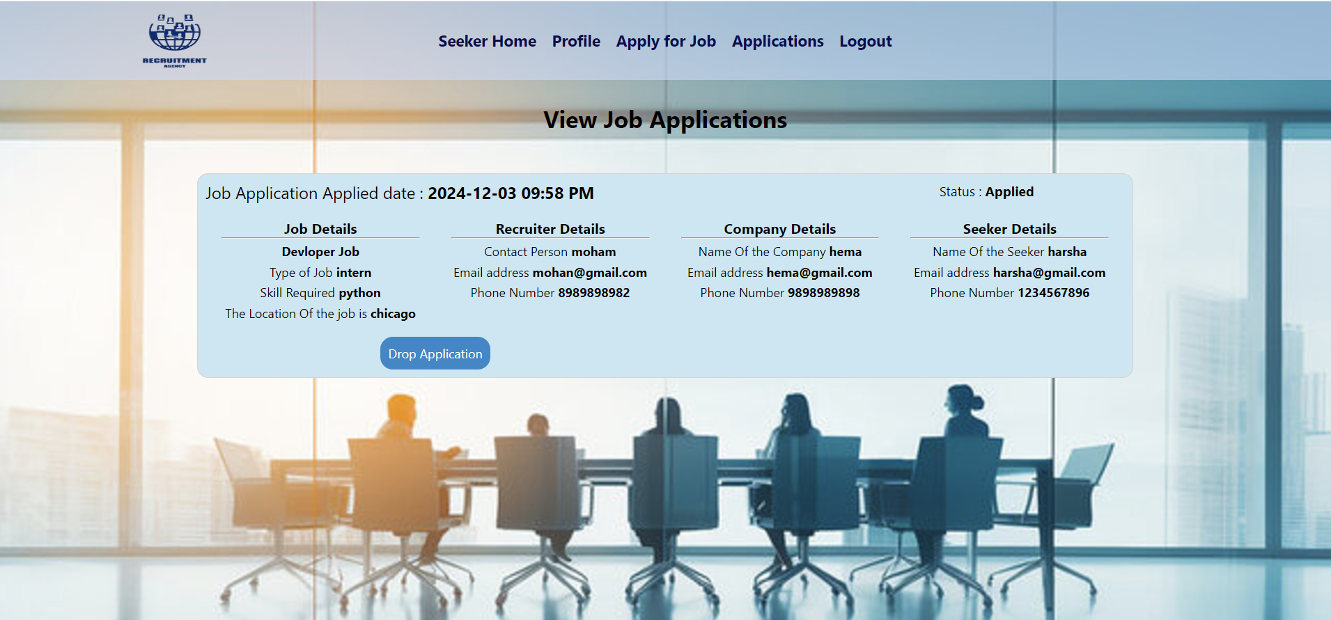
View Job Application Page :

Slide 33
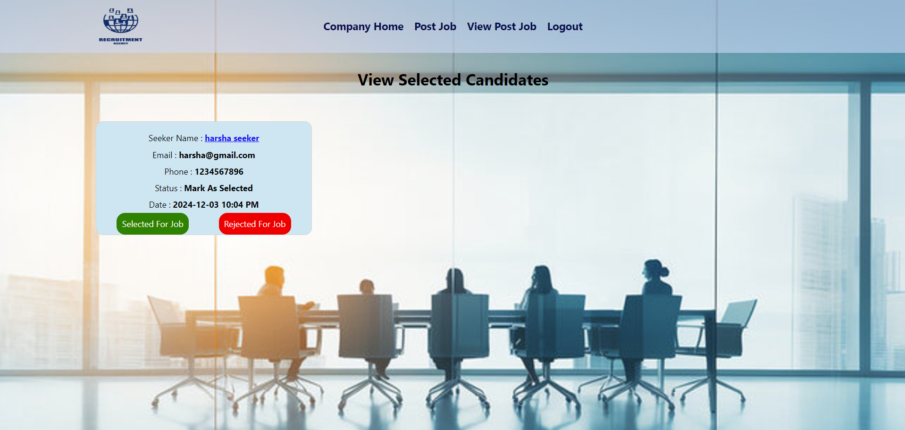
Company View Job Candidates Page :

Slide 34
Deployment
The project is hosted on Render, allowing for easy access and scalability. The application can be accessed via the following link:
https://emprecprocess.onrender.com
The source code is managed through Git, ensuring version control and collaboration.

Slide 35


